Slide 1
Serverless Computing

Slide 2
Agenda
What is serverless computing?
Are there servers in serverless computing?
Benefits of using serverless computing.
Limitations of serverless computing.
Use cases.

Slide 3
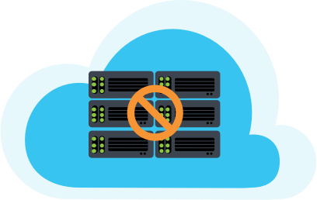
Serverless Computing
New and opposite to the traditional method.
Managing
Provisioning or,
Maintaining servers.
Developer managed all the things.

Slide 4
Serverless Computing
Job of establishing.
Maintaining, and
Scaling the server infrastructure.
AWS or some other cloud provider.

Slide 5
Serverless Computing
Demand.
Scale up and down.
Metered on-demand using an event-driven execution approach.
Does not cost anything when it is idle.

Slide 6
Servers in Serverless?
No servers
Customer doesn't see,
Manage, or
Interact.
Serverless has no servers.
Reduced.

Slide 7

Benefits
Cost-effective:
Principle of minimising costs.
No need to pay a premium to buy, set up, and hire skilled personnel.
No need to invest money or time.
Build our product.

Slide 8

Benefits
Scalable:
Boost in usage,
From a viral marketing.
Serverless allows us to handle as many requests.
Without sacrificing performance.
Number of functions.

Slide 9
Benefits
Improves efficiency:
Primary coding jobs, they can work more efficiently.
Core work.
Software trends.
User experience expectations.

Slide 10
Limitations
Response time is delayed.
Drawback of migrating to serverless computing.
Triggering of a request.
Referred to as response latency.
Drift and be processed.
Time is crucial.

Slide 11

Limitations
Restriction:
Serverless computing can restrict us.
Not suitable for high-computing tasks,
Resource limitations imposed by vendors.
Third-party provider.

Slide 12

Limitations
Security:
For security.
Customers may feel safer.
Consumers have no redress if an attack happens.
Rely on the provider to reveal, repair, and recover.

Slide 13
Use cases
Microservices and serverless architecture.
Creation of small services.
Qualities of small amounts of code,
Inherent and automated scaling.
Rapid provisioning.
Pricing model that never costs for idle capacity.

Slide 14

Use cases
Substantial popularity.
Useful for common applications.
Customer relationship management (CRM).
Analytics and business intelligence.
Finance, and more.

Slide 15
Use cases
Backend for APIs:
HTTP endpoint that can be used by web clients.
Full-featured API with additional security.
OAuth support.
Rate restriction, and
Custom domain support.

